Slide 1
JUICE
PICTURE ITS FINAL

Slide 2
DESIGN CRITERIA
Supportive materials through improved/enhanced illustration style and visual design which add value
Establish visual conventions which reflect a JUICE style
These conventions should be easily updatable / templatable without the need for advanced software such as Photoshop
The images and approaches need to be sensitive to the diverse cultural base of users as well as relate to those users through real world scenarios
Avoid visual noise and confusion, keep it simple
Illustrations should present the equivalent of a mnemonic device
Text based samples should be annotated
Establish a set of templates for further creation in-house

Slide 3

Assets rebuilt in Google Slides
Note to selves on the call-outs. This 1.5 weight may be too heavy if there are a lot of them. The Audience and Purpose samples switch to 1.
Fix this.
Fix this.
Yes
No
Yes
No
Yes
No
Yes
No
Does it have two or more independent clauses that can stand on their own?
This is an example of a success note.
This is an example of a warning note.
Example of crossed-out text.

Slide 4
Assets rebuilt in Google Slides
Fix this.

Slide 5
Ask yourself: Deciding if a sentence is a run-on
Ask yourself: Is the sentence a run-on?
Does it have two or more independent clauses that can stand on their own?
No
Yes
You DO NOT have a run-on!
Does it have either a semicolon or a comma and a joining word such as and to join the clauses?
Yes
No
You DO have a run-on. You need to fix it.

Slide 6
Fixing run-ons: Picture it
Three ways to fix a run-on
Training benefits every dog it also creates a bond between dog and owner.
Make two shorter sentences
It
.
Training benefits every dog it also creates a bond between dog and owner.
Add a comma and a joining word
and
^
,
Training benefits every dog it also creates a bond between dog and owner.
Add a semi-colon
;
Notes:
Includes notes from Kate. See top example for placement of the pencil. Treat as an icon.

Slide 7
Fixing run-ons: Picture it
Add a comma and a joining word
and
^
,
Training benefits every dog it also create a bond between dog. But I must explain to you how this all mistaken idea of denouncing pleasure and praising pain was born I will give you a complete account of the the system, and expound the actual teachings of the great explorer of the truth, the West master-builder of human happiness.
Start a new sentence
Omit extra words
.
Notes:
See spacing notes on run-on sentences

Slide 8
Plurals and Possessives
Plural nouns: More than one of a person, place, or thing
Add an s:
cat + s
cats
match + es
matches
Do not use an APOSTROPHE
Add an es:
Change the y to an i and add an es:
beauty i + es
beauties
Irregular cases:
mouse
mice
Remember to check a dictionary for Irregular cases
Possessive nouns: Show ownership
Singular
Add an apostrophe + s:
cat + ’ + s
cat’s
Plural
Add an apostrophe only:
cats + ’
cats’
Do not add an s after the apostrophe
Possessive pronouns:
NO apostrophe:
its
his
her
Do not use an APOSTROPHE
Do not use it’s to show possession.

Slide 9
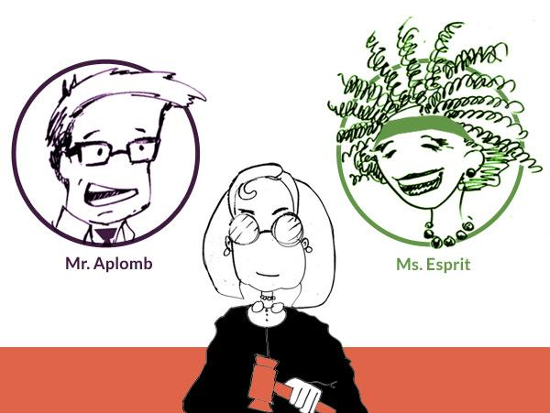
Aplomb + Esprit
What is my argument?

Slide 10
Aplomb + Esprit
Here’s why I’m right!

Slide 11
Aplomb + Esprit
Here’s why you’re wrong!

Slide 12
Aplomb + Esprit
Here’s why YOU’RE wrong!

Slide 13
Aplomb + Esprit
Who should win?

Slide 14
Aplomb + Esprit
Who should win?

Slide 15







Building a Strong Argument
Make a claim
Give a reason
If you can’t rebut, go back & strengthen your argument
Building A Strong Argument
Provide support
Rebut the counter- argument
Imagine the counter-argument

Slide 16

Empty with more gray by Betsy

Slide 17
Problem Solving Strategy
We will use Betsy’s instead, but Betsy will likely update the text to match these colors.
Problem Solving Strategy
We will use Betsy’s but I will probably update the colors.
Step 1:
Ask yourself what you are trying to find and what you already know.
Start
Step 2: Write a math expression.
Step 3: Do the math.
Step 4: Make sure your answer makes sense. If it does go to Step 5.
If it does not, check your calculations, then go back to Step 1.
Step 5: State your answer including units.

Slide 18
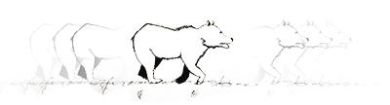
Tense Timeline
Showing time with verb tenses
Past
It happened.
The bear rushed.
Now (Present)
It happens.
The bear rushes.
The bear is rushing.
Future
It will happen.
The bear will rush.
Notes:
Note on size: We can ensure that the image will be scaled down to 400px width. Betsy: Can you please align Future with the other two? It’s a little lower.
Alex: Adjusted text.

Slide 19
Tense Timeline
Showing time with verb tenses
Past
It happened.
The car raced.
Now (Present)
It happens.
The car races.
The car is racing.
Future
It will happen.
The car will race.
Notes:
Try it 1

Slide 20



Tense Timeline
Showing time with verb tenses
Past
It happened.
The car raced.
Now (Present)
It happens.
The car races.
The car is racing.
Future
It will happen.
The car will race.
Notes:
Try it 2

Slide 21



Tense Timeline
Showing time with verb tenses
Past
It happened.
The visitor walked.
Now (Present)
It happens.
The visitor walks.
The visitor is walking.
Future
It will happen.
The visitor will walk.
Notes:
Try it 3

Slide 22
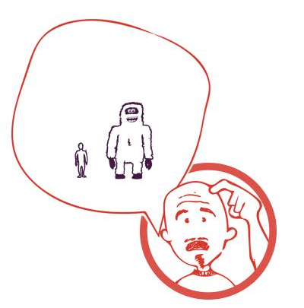
Problem Solving: Giganto-mart
Make sense yeti
Hmm, My answer is that Joe is 14 feet tall. Can that be right?
14 feet
6 feet
Human
Yeti

Slide 23

Problem Solving: Giganto-mart
Membership Flyer
Giganto-Mart Membership!
$15 a month for:
5% off all grocery purchases Discount mobile phone plans Rebates on all electronic purchases over $599 Car and home loans at great rates

Slide 24

Problem Solving: Giganto-mart
Membership Flyer
Giganto-Mart Membership!
$15 a month for:
5% off all grocery purchases Discount mobile phone plans Rebates on all electronic purchases over $599 Car and home loans at great rates

Slide 25

Problem Solving: Giganto-mart
Peanut butter, turkey, and catering sale
Peanut Butter Sale!
Yummy 20 oz. jar for $3.00
Tasty 12 oz. jar for $2.40

Slide 26
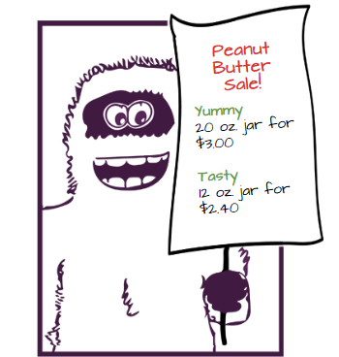
Problem Solving: Giganto-mart
Peanut butter, turkey, and catering sale
Version shortened in paint.net for better fit in 1366 x 768

Slide 27
Problem Solving: Giganto-mart
Peanut butter, turkey, and catering sale
Turkey Sale!
Penny B’s 2 lb for $9.89
Friday Farms 3 lb for $14.43

Slide 28
Problem Solving: Giganto-mart
Peanut butter, turkey, and catering sale
Which Caterer?
Cypress Caterers $874.50 for 110 lunches
Jules Catering $966 for 120 lunches

Slide 29
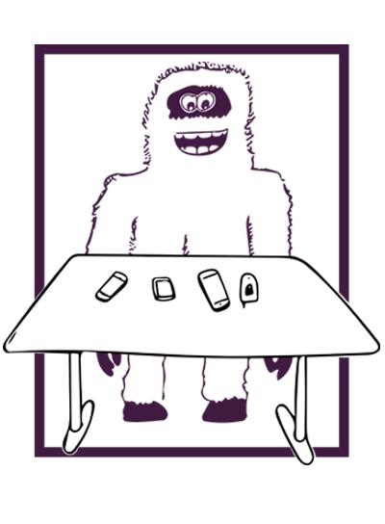
Problem Solving: Giganto-mart
Cell phone

Slide 30
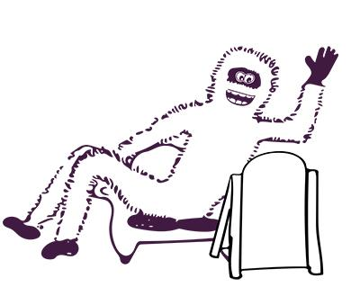
Problem Solving: Giganto-mart
Pay Now or Pay Later
PAY $700 NOW OR
$25 down and $140 a month

Slide 31
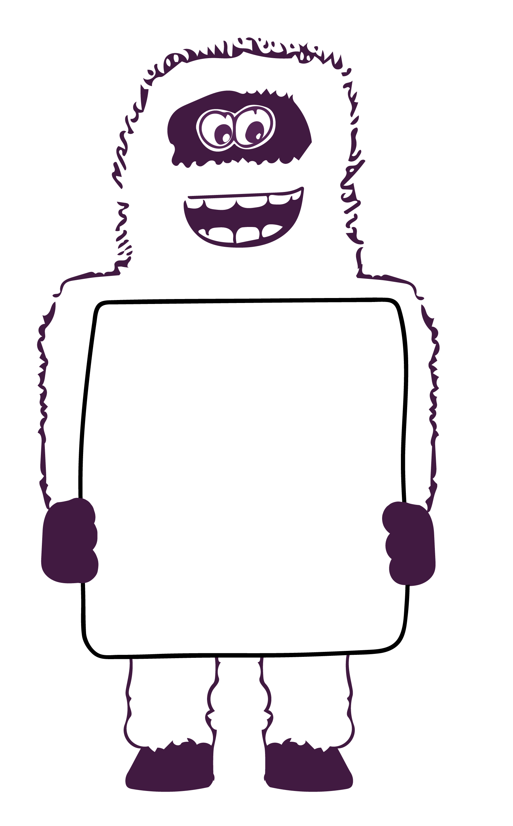
Problem Solving: Giganto-mart
Extra Yeti
Hi Mom!

Slide 32
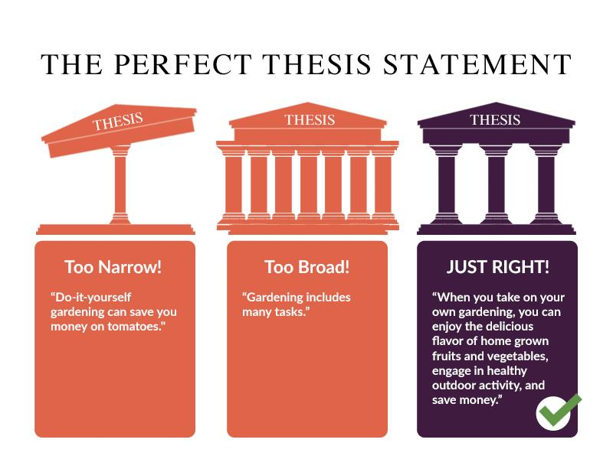
The Perfect Thesis Statement
Effective thesis statement
Too Narrow!
“Do-it yourself gardening can save you money sometimes."
JUST RIGHT!
“When you take on your own gardening, you can enjoy the delicious flavor of homegrown fruits and vegetables, engage in healthy outdoor activity, and save money. ”
Too Broad!
“Gardening includes many tasks.”

Slide 33



Topic Sentence Illustration
Effective topic sentence
Too Narrow!
“My stay at your motel last month was a terrible experience for my family and me because of the uncomfortable beds."
JUST RIGHT!
“My stay at your motel last month was a terrible experience for my family and me because of the poor quality of the motel and the poor service.”
Too Broad!
“I stayed at your motel last month.”

Slide 34
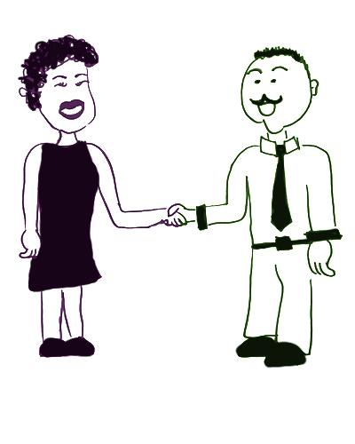
Compelling Introduction
A compelling introduction
Hi, I'm Jose. I'm a product director for a large company that builds widgets. Every American uses a widget at least 5 times each day! The best way to make widgets that everyone will buy is to talk to widget customers about what they want; make widgets of the highest quality; and provide excellent service.
Hi! I’m Marcia. My company makes gadgets.
Jose has started with a sentence to interest Marcia, provided background information about widgets, and closed with a statement that lists three things he wants to discuss.

Slide 35
Effective Conclusion
An effective conclusion
Goodbye Jose! Remember that gadgets are going to be the next big thing. They can make everyday tasks much simpler. They are easy to use with clear and complete instructions. Gadgets are fun to use, too, and can make the most boring tasks seem like a game. You should go out and buy a gadget today!
Bye. Thanks for talking with me.
Marcia has restated the key points she made about gadgets in her talk with Jose, and ended with a call to action.

Slide 36
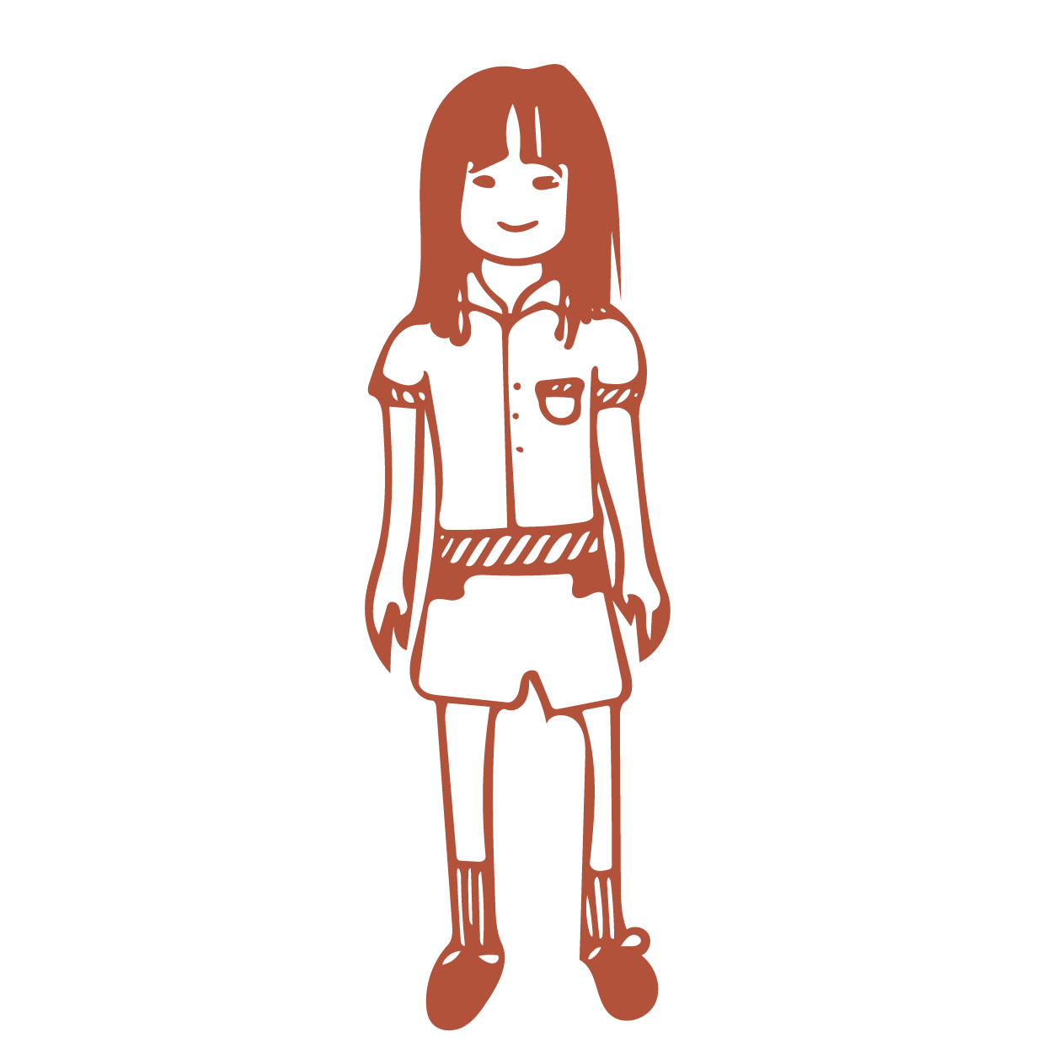
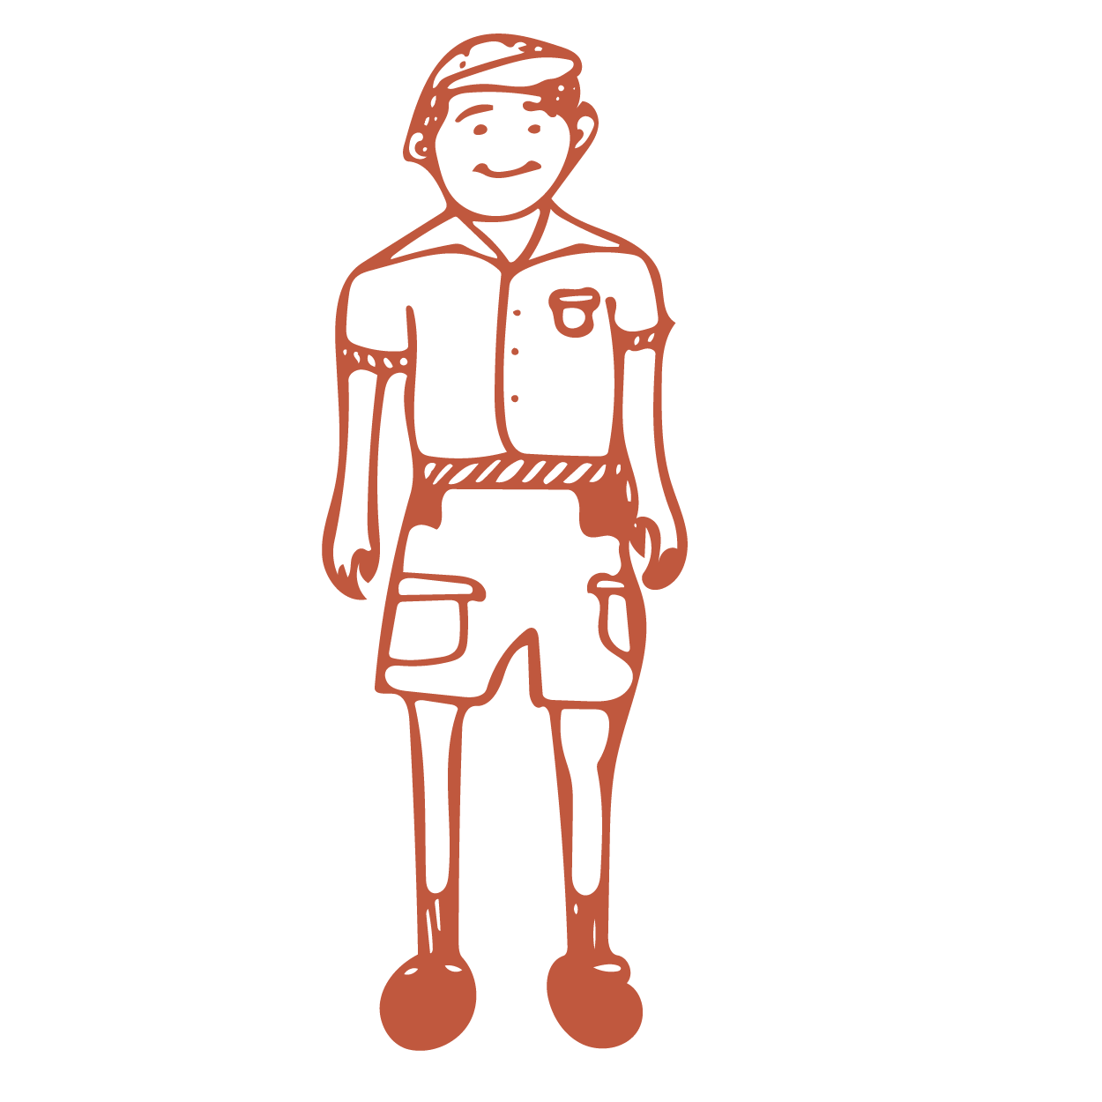


Sentence Fragments: Missing a verb
Missing a verb
A highly qualified staff
Does what?
Complete sentence
A highly qualified staff
cares for the elephants.

Slide 37
Sentence Fragments: missing a subject
Missing a subject
Who?
seeks companionship
Complete sentence
The elephant
seeks companionship.

Slide 38


Sentence fragments: dependent clause without an independent clause
Dependent clause
Because the elephants require the ability to roam
What happens because of this?
Complete sentence
Because the elephants require the ability to roam
sanctuaries provide lots of space.

Slide 39
How Sentences Work
See other dec for this example:
https://docs.google.com/a/ifactory.com/presentation/d/1FI642d3wfdSjz_m6IZxXR_VNJG3PjgfuTmb0ptKslb8/edit?usp=sharing

